Slide 1
1
Organic RFIDs Ryan Denomme Rajesh Kumar NE 479 Project Presentation Winter 2010

Slide 2
Background
ORFIDs work similar to Si RFIDs
Antenna + Chip + Package + Tag Reader
Reader broadcasts RF signal that powers chip, chip sends ID back to reader, all through induction at antenna
No major changes in operation, but circuitry is different
No organic CMOS (right now)
Large amount of research on ORFIDs started in 2004/2005
Pentacene, printed or evaporated
Antenna
Chip
Notes:
-How do RFIDs work? Components (antenna + chip + package + tag reader). We focus on the chip – using organics to build instead of Si.
-Si circuits replaced with organic circuits
-Reader sends RF signal which induces current in the antenna through magnetic induction. The chip rectifies the AC signal to charge a capacitor, powering the chip. The chip ID (and possibly other information) is then sent out back to the reader through the antenna. The output signal is modulated in time by the tags unique ID, which is then picked up by the reader again through induction.

Slide 3
Key Requirements
Very fast switching speed (in MHz range)
Currently at 135 KHz, very latest developments demonstrate 13.56 MHz
Need this for item-level RFID labeling (main ORFID market)
Long shelf life
Stability of pentacene (~1-2 years)
Threshold voltage shifts over time, affects lifetime
Low cost of fabrication
1-2 cents per RFID tag required
Low cost achieved by printing
Notes:
-Explain why need 13.56 MHz for item level labelling:
-Higher frequencies like 900 MHz will be affected by the material that the label is attached to, such as metal or water inside of the container.
-Lower frequencies require too large of circuit components and are more expensive to make
- 20% shift in threshold voltage will alter output power and may make signal undetectable

Slide 4
Technology and Applications Perspective
Barrier: Carrier Mobility
Needs to be high for 13.56 MHz
Would like good order and stacking –pi-pi stacking, E_{g} reduces
Organic vs. Silicon
10¢ for silicon RFIDs
Need to go down to 1-2¢ – can only be achieved with cheap organics
Low processing costs
Cost savings
$3 billion for silicon foundry
$1-10 million for organic printing facility
Alternatives
traditional barcodes
Silicon RFID
magnetic attachments (retail stores)

Slide 5
Key Aspects of Technical Design: Key Requirements
Operating frequency
13.56 MHz
Mobility
Pentacene: 0.1-1 cm²/V-s
Operating voltage
Currently 10-20 V
But need 3-5 V
Cost
1-2¢
Higher than typical barcodes, but more savings down the line

Slide 6
6
Key Aspects of Technical Design: Materials
Semiconductor:
Pentacene: mobility close to a-Si, many processing options, commercially available, can functionalized for solution printing
Oligiothiophenes: Poly3-Hexylthiophene (P3HT), Fluorene-co-Bithiophene (F8T2)
Oxides:
PMMA, PVP, soluble inorganics
Contacts:
PEDOT/PSS, PANI, Au/Pt Nanoparticles
Substrates:
Polyester, polyimides, paper
Notes:
-Pentacene-can be functionalized to be soluble and printable
-Oligiothiophenes can exhibit better stability in air and less Vth shift, but generally have lower mobility. These molecules are also investigate as soluble for printing purposes
-Want lots of ordered packing for pi-pi overlap to produce high mobility
-Add some notes on the other materials on this slide
-PMMA = poly(methyl methacrylate)
-PVP = polyvinylphenol
-PEDOT/PSS = Poly(3,4-ethylenedioxythiophene) poly(styrenesulfonate) – conductive polymers
PANI = polyaniline
-Au/Pt NPs are printed in solution and then annealed

Slide 7
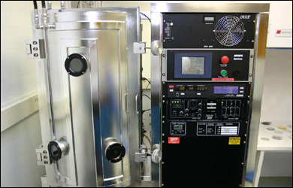
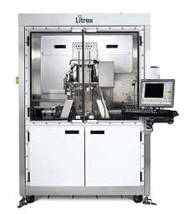
7
Key Aspects of Technical Design: Processes
Vacuum deposition:
highest mobility and purity, but cost similar to Si and low throughput (for pentacene)
requires shadow mask
Solution printing:
Inkjet: parallel, cheap, poor resolution (30-40µm)
Spin coating: cheap, but often needs photolitho
Usually photolitho + inkjet + spin coating
Intlvac Evaporator
Litrex Printer
Notes:
Solution printing: can also have screen printing and laser thermal annealing (better resolution, to 5um, but not as developed)

Slide 8
8
Key Aspects of Technical Design: Structures
Typically back gate OTFT used for active circuit components
Use Schottky junction or diode connected OTFT to make rectifiers, ring oscillators and multiplexers
Channel length must permit 13.56 MHz
Need thin oxides to lower V_{th}
Notes:
-PN junctions are not easily formed in organics, especially since N type organics are not as good as ptype
-Rectifier changes AC RF signal into a DC signal to power the device
-Main structural challenges are reducing channel length, making monolayer thin SC channels for better mobility, making very thin dielectrics for lower voltage operation
-Schottky junction is formed between a metal and a semiconductor (as oppose to 2 semiconductors like in a p-n junction)
-Diode connected OTFT has the gate shorted to the source – constant current souce

Slide 9
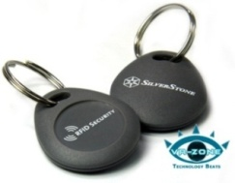
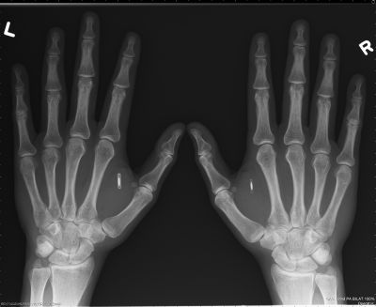
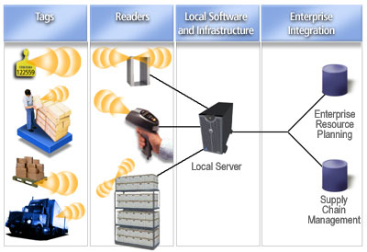
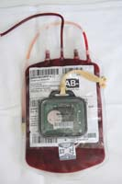
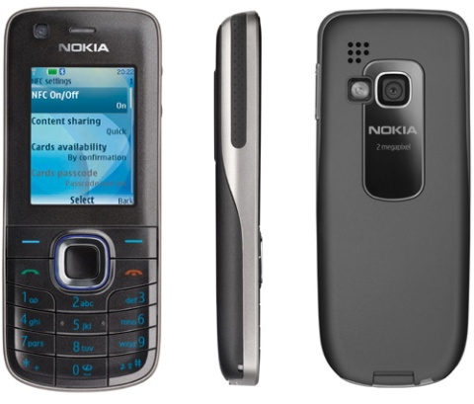
9
Commercialization Outlook
Cost per chip must reduce to 2¢ for item level tagging
-Can organics do it?-
Applications:
Hospitals, security, tracking, supply chain management,
smart payment → barcode replacement
Notes:
Major apps for ORFID: -replacing barcodes with smarter bar codes, tagging merchandise on a item by item scale. Touch to pay
http://www.rfidnews.org/ - blood bag
http://www.digitivity.com/articles/2008/12/rfid-tags.html – supply chain picture
http://www.nearfield.org/2008/05/thoughts-on-nokias-nfc-developments - phone pic
http://www.thetechlounge.com/list-news/87-13/Hardware/ - key pic

Slide 10
10
Commercialization Outlook
Companies (no commercial ORFID products):
ORFID Corp: vertical OFET, startup
MIT Auto-ID Labs: research collaboration btw industry and academia
Market Projection
More than 5 billion bar codes scanned daily
MIT Auto-ID identifies 555 billion items to be individually tagged from major partners (Walmart, Coca-Cola, etc)
Si based RFID market already large

Slide 11
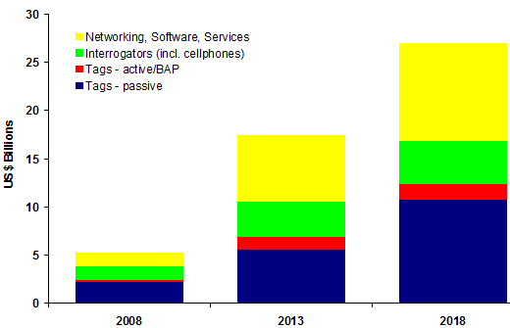
11
Commercialization Outlook
IDTechEx Market Prediction for RFIDs
Huge potential for ORFIDs
Notes:
-chart from http://www.printedelectronicsworld.com/articles/idtechex_rfid_market_projections_2008_to_2018_00000813.asp

Slide 12
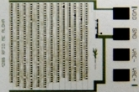
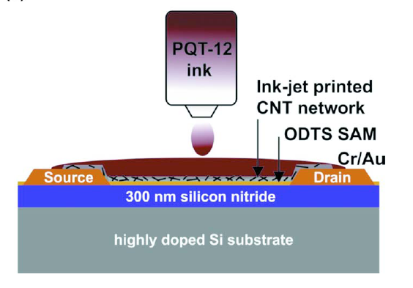
12
Recent Advances
Areas of Focus:
Increasing mobility
Lowering and stabilizing V_{th}
Matching n- and p-type for CMOS style circuit implementation
More bits, higher bit rate over larger distances
State of the Art:
5.5 cm²/V∙s mobility for evaporated pentacene, 1.8 for solution processed
15 month stability p-type (anthracene)
1 cm²/V∙s for new n-types
Breakthrough 13.56 MHz ORFID, 128-bit transfer
at 2kb/s, pentacene back gate (2009, Holst Center)
CNT + Polythiophene inkjet printed for
enhanced mobility (7x)
Holst Center 13.56 MHz ORFID
Notes:
13.56 MHz - http://www.holstcentre.com/en/NewsPress/PressList/Holst%20Centre%20reports%20major%20step%20towards%20organic%20RFID.aspx

Slide 13
13
References
[1] E. Cantatore and e. al, "A 13.56-MHz RFID system based on Organic Transponders," IEEE Journal of SOlid-State Circuits, vol. 42, no. 1, Jan. 2007.
[2] G.-W. Hsieh and e. al, "High performance nanocomposite thin film transistors with bilayer carbon nanotube-polythiophene active channel by ink-jet printing," Journal of Applied Physics, vol. 106, 2009.
[3] J. R. Sheats, "Manufacturing and commercialization issues in organic electronics," J. Mater. Res., vol. 19, no. 7, Jul. 2004.
[4] D. M. Leeuw and E. Cantatore, "Organic electronics: materials, technology and circuit design developments enabling new applications," Materials Science in Semiconductor Processing, vol. 11, 2008.
[5] M. Chason and e. al, "Printed organic semiconducting devices," Proc. of the IEEE, vol. 93, no. 7, Jul. 2005.
[6] V. Subramanian and e. al, "Printed organic transistors for ultra-low-cost RFID Applications," IEEE Trans. on Components and Packaging Technologies, vol. 28, no. 4, Dec. 2005.
[7] V. Subramanian and e. al, "Progress toward development of all-printed RFID tags: materials, processes, and devices," Proc. of the IEEE, vol. 93, no. 7, Jul. 2005.
[8] T. Kelley and e. al, "Recent progress in organic electronics: materials, devices, and processes," Chem. Mater, vol. 16, no. 23, pp. 4413-4422, 2004.
Notes:
13.56 MHz - http://www.holstcentre.com/en/NewsPress/PressList/Holst%20Centre%20reports%20major%20step%20towards%20organic%20RFID.aspx

Slide 14
14
Thank You
Questions?
Notes:
13.56 MHz - http://www.holstcentre.com/en/NewsPress/PressList/Holst%20Centre%20reports%20major%20step%20towards%20organic%20RFID.aspx

